Slide 1
MSIA/Cyber Security Program
DSM 955
Introduction to Python
“How to make a Python Calculator”
Daniel Akalu, Olalekan Bello, & Alicia Fiallo

Slide 2
Introduction
Agenda
How we collaborated
Research and Development

Slide 3
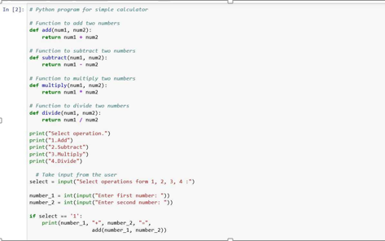

Slide 4
